Slide 1

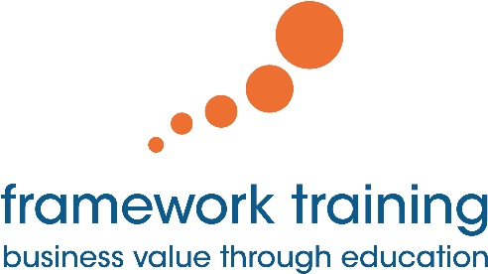
Welcome & Introductions
Framework Training

Slide 2
Introductions
Course Instructor
Introduction
Course attendees
You…
Name
Professional Position
Python / Programming experience
Motivation and Expectations

Slide 3
Course Content
Course objectives
Learn core aspects of the Python language
On this course we are looking at:
What Python is and the Python environment
Python Syntax, Types & Flow of control
Python Functions and Higher Order functions
Intro to Object Oriented Programming in Python
Python Protocols
Iterators and Generators
Intro to Testing in Python
Introduction to Threads & Processes
Files and Error Handling

Slide 4
Questions?
?

